Slide 1
EMPLOYEE FLOWCHART

Slide 2
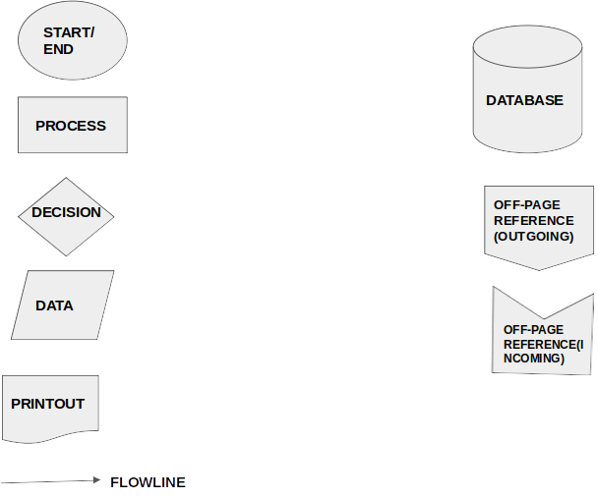

Slide 3
START
Y
USER NAME
PASSWORD
LOGIN
VALID
?
N
FORGOT
PASSWORD
?
N
Y
Y
EMAIL
EMAIL
OPERATION
EMAIL
RESET
C
N
SUCCESSFUL
?
Y

Slide 4
B
MANAGE
ATTENDANCE
?
N
D
Y
N
N
CREATE
ATTENDANCE
?
VIEW
ATTENDANCE
?
Y
Y
ENTER EMPLOYEE DETAILS,HOURS WORKED
ENTER
EMPLOYEE
INFORMATION
CREATE
ATTENDANCE
DATA
QUERY
MANAGE
DATA
VIEW
ATTENDANCE
C

Slide 5
A
MANAGE
EMPLOYEE
?
N
B
A
Y
ADD
EMPLOYEE
?
N
VIEW
EMPLOYEE
?
N
N
N
UPDATE
EMPLOYEE
?
SOFT
DELETE
?
Y
Y
Y
Y
ENTER EMPLOYEE DETAILS
SEARCH
PARAMETER
ENTER EMPLOYEE DETAILS,STATUS
SOFT
DELETE
ADD
EMPLOYEE
QUERY
DATA
UPDATE
EMPLOYEE
MANAGE
EMPLOYEE
VIEW
EMPLOYEE
FEEDBACK
C

Slide 6
D
MANAGE
PERFOMANCE
?
N
E
Y
CREATE
PERFORMANCE
VIEW
PERFOMANCE
?
N
N
Y
ENTER
EMPLOYEE
DETAILS,STATUS
ENTER
EMPLOYEE
DETAILS,STATUS
CREATE
PERFORMANCE
QUERY
DATA
MANAGE
EMPLOYEE
VIEW
PERFORMANCE
C

Slide 7
E
MANAGE
REPORTS
?
N
G
Y
VIEW
REPORTS
?
N
PRINT
REPORTS
?
N
Y
Y
SELECT
REPORT
QUERY
DATA
VIEW
REPORTS
C

Slide 8
G
E
CHANGE
PASSWORD
?
N
Y
OLD PASSWORD
NEWPASSWORD
REPEAT PASSWORD
CHANGE
PASSWORD
N
SUCCESSFUL
N
LOGOUT
C

Slide 9
C
OPERATION
DATABASE
Y
Y
Y
Y
Y
N
LOGOUT
?
Y
LOGOUT
LOGIN
N
EXIT
?
Y
END

